Slide 1

Security & Identity
SQL Injection, XSS, CSRF, Authentication, Authorization, Identity, GDPR
SoftUni Team
Technical Trainers
Software University
http://softuni.bg

Slide 2
Table of Contents
Security Fundamentals
Most common attacks
SQL Injection
XSS
CSRF
Parameter Tampering
Authentication & Authorization
ASP.NET Core Identity
GDPR

Slide 3
Have a Question?
sli.do #csharp-web

Slide 4




Security Fundamentals
The concepts of Web Security

Slide 5





Security Fundamentals
Web Security encompasses measures to improve an app’s security
Often done by fixing and preventing security vulnerabilities
Vulnerabilities are ever-evolving but mostly – largely consistent
“One thing is considered secured, when breaking its security costs more than the value received by doing so…”

Slide 6


Security Fundamentals
Security Breaches often happen spontaneously
The vulnerability can be completely unintentional
Security Breaches are the result of malicious attacks
These attacks may have many motives backing them
Challenge / Prestige, Curiosity, Vandalizing, Stealing
Security Breaches can be completely discrete
Highly-experienced attackers will not leave any trace
You will most likely realize you were attacked a lot later

Slide 7
Security Fundamentals
There is a wide range of known types of threats and attacks
There is an even wider range of unknown threats and attacks…
Category | Threats / Attacks
Input Validation | Buffer overflow, cross-site scripting, SQL injection, canonicalization
Parameter Tampering | Query string manipulation, form field manipulation, cookie manipulation, HTTP header manipulation
Session Management | Session hijacking, session replay, man-in-the-middle
Cryptography | Poor key generation or key management, weak or custom encryption
Sensitive Information | Access sensitive code or data in storage, network eavesdropping, code/data tampering, Admin password in exceptions
Exception Management | Information disclosure, denial of service

Slide 8





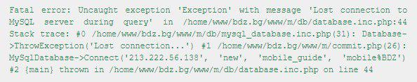
Security Fundamentals
Some of the best actions a developer can take to secure an app
Maximum Simplicity
Securing the Weakest Link
Limiting the Publicly Available Resources
Incorrect until proven Correct
The “Weakest Privilege” Principal
Security in Errors
Provide Constant defense
Dev

Slide 9
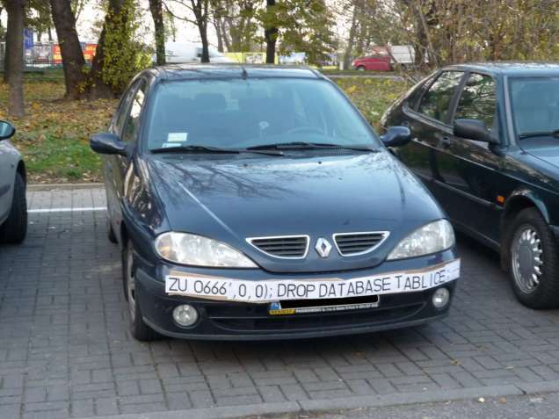
SQL Injection

Slide 10
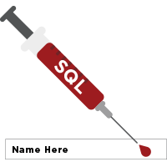
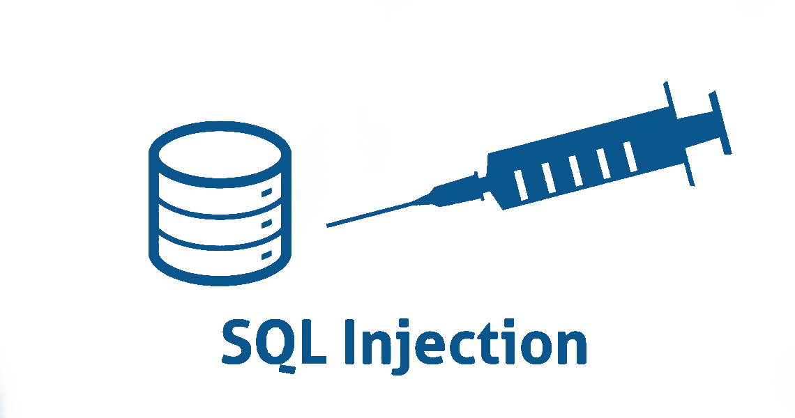
SQL Injection
The following SQL commands are executed:
Usual search (no SQL injection):
SQL-injected search (matches all records):
SQL-injected INSERT command:
SELECT * FROM Messages WHERE MessageText LIKE '%Nikolay.IT%'"
SELECT * FROM Messages WHERE MessageText LIKE '%%%%'"
SELECT * FROM Messages WHERE MessageText LIKE '%' or 1=1 --%'"
SELECT * FROM Messages WHERE MessageText
LIKE '%'; INSERT INTO Messages(MessageText, MessageDate) VALUES ('Hacked!!!', '1.1.1980') --%'"

Slide 11
SQL Injection
Original SQL Query:
Setting username to John & password to ' OR '1'= '1 produces
The result:
The user with username – “Admin” will login WITHOUT password
The pass query will turn into an bool expression which is always true
String sqlQuery = "SELECT * FROM user WHERE name = '" + username + "' AND pass='" + password + "'";
String sqlQuery = SELECT * FROM user WHERE name = 'Admin' AND pass='' OR '1'='1'

Slide 12
XSS
Cross Site Scripting (XSS)

Slide 13

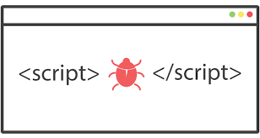
XSS
Cross-site scripting (XSS) is a common vulnerability in Web apps
Web applications display a JavaScript code
Executed at the client's browser
Crackers could take control over sessions, cookies, passwords, etc.
How to prevent from XSS?
Validate the user input (built-in in ASP.NET Core)
Perform HTML escaping when displaying text data

Slide 14




XSS
Cross-site scripting attack
Cookie theft
Account hijacking
Modify content
Modify user settings
Download malware
Submit CRSF attack
Password prompt
Execute the script on visiting the page
Submits script on an unsafe form

Slide 15
XSS
ASP.NET Core secures you against XSS to the maximum possible
If you decide to break it, you most probably will succeed
There are several rules you must follow to be secured:
Never put untrusted data into your HTML input
Before putting untrusted data somewhere, ensure it is secured
Encoded, Parsed, Validated, Checked for malicious contents
Untrusted data can be inputted anywhere in the application
URLs, HTML Elements, HTML Attributes, JavaScript code etc.

Slide 16
XSS
ASP.NET Core provides you with anything needed to secure your app
Razor automatically encodes all output sourced from variables
You can inject Encoders directly to your Views and use them.
@{ var untrustedInput = "<\"123\">"; }
@untrustedInput
&lt;&quot;123&quot;&gt;
@using System.Text.Encodings.Web;
@inject JavaScriptEncoder encoder;
@{ var untrustedInput = "<\"123\">"; }
<script>
document.write("@encoder.Encode(untrustedInput)");
</script>
<script>
document.write("\u003C\u0022123\u0022\u003E");
</script>

Slide 17

XSS
You can also the Encoders on the Back-end, as services
public class HomeController : Controller
{
private readonly HtmlEncoder htmlEncoder;
private readonly JavaScriptEncoder javaScriptEncoder;
private readonly UrlEncoder urlEncoder;
public HomeController(HtmlEncoder htmlEncoder,
JavaScriptEncoder javascriptEncoder,
UrlEncoder urlEncoder)
{
this.htmlEncoder = htmlEncoder;
this.javaScriptEncoder = javascriptEncoder;
this.urlEncoder = urlEncoder;
}
}

Slide 18
CSRF
Cross-Site Request Forgery

Slide 19
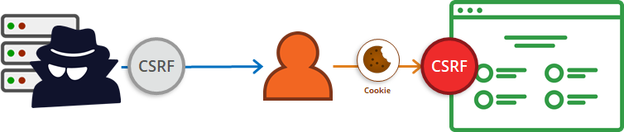
Cross-Site Request Forgery
Cross-Site Request Forgery (CSRF / XSRF) is a web security attack over the HTTP protocol
Allows executing unauthorized commands on behalf of some user
The user has valid permissions to execute the requested command
The attacker uses these permissions maliciously, unbeknownst to the user

Slide 20
Cross-Site Request Forgery
The process is not that complex to comprehend:
The user has an valid auth cookie for the site victim.org
This is stored in the browser
The attacker asks the user to visit http://evilsite.com
The attacker takes the stored cookie
The evil site sends HTTP Request to victim.org using the cookie
The victim.org performs actions on behalf of the user
After all, the actions is done using the user’s credentials

Slide 21
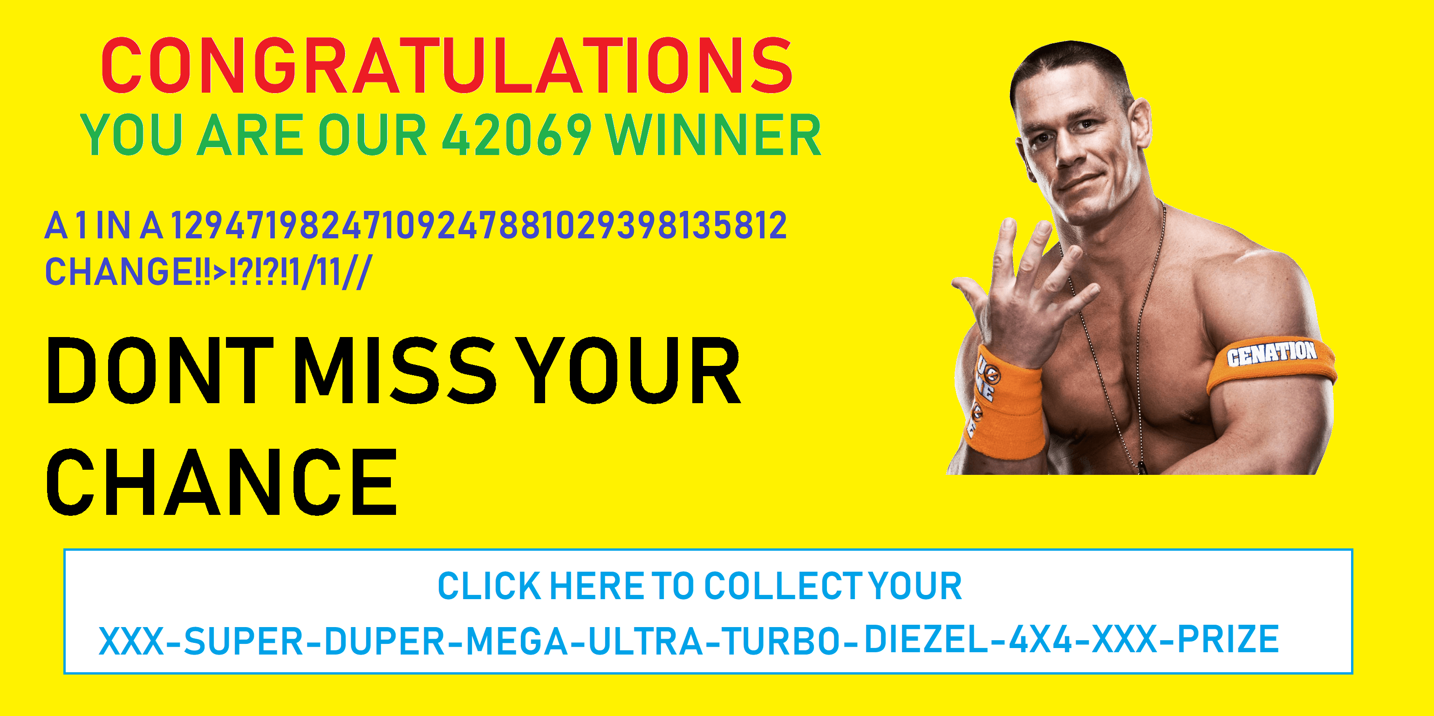
Cross-Site Request Forgery
What Cross-Site Request Forgery usually looks like:

Slide 22

Cross-Site Request Forgery
What Cross-Site Request Forgery actually is:
The user can even misclick the button accidentally
This will still trigger the attack
Security against such attacks is necessary
It protects both your app and your clients
<!-- SOME MULTI-COLOR USELESS CLICKBAIT CONTENT --> <form action="http://good-banking-site.com/api/account" method="post">
<input type="hidden" name="Transaction" value="withdraw">
<input type="hidden" name="Amount" value="1000000">
<input type="submit" value="Click to collect your prize!">
</form>

Slide 23
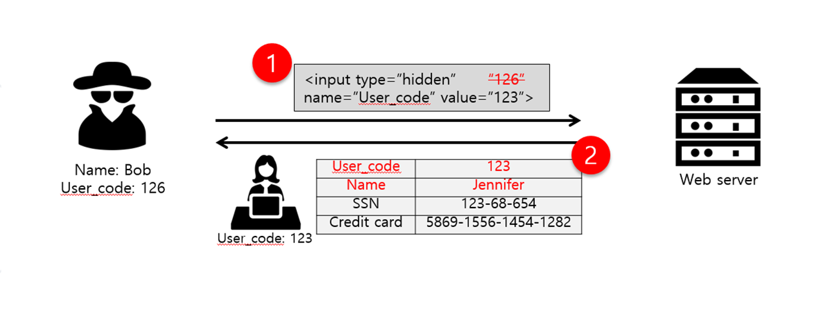
Parameter Tampering

Slide 24
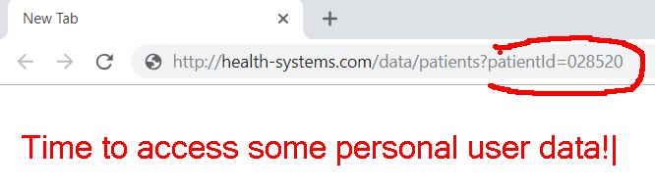
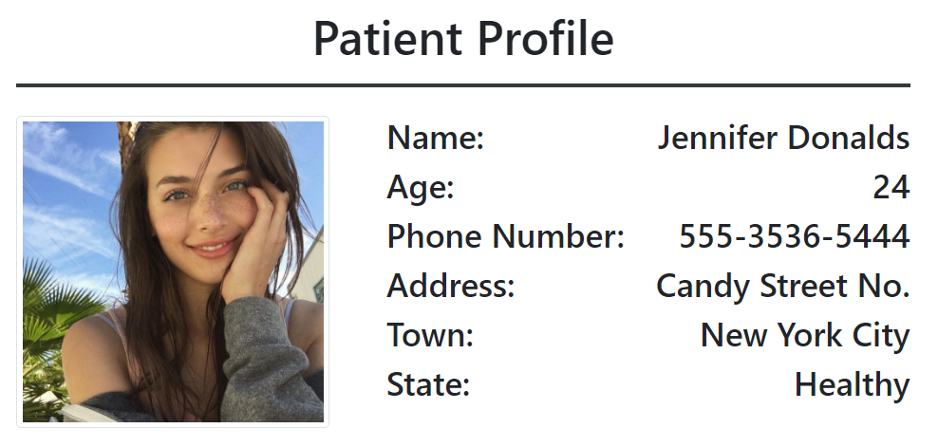
Parameter Tampering
Parameter Tampering is the manipulation of parameters exchanged between client and server
Altered query strings, request bodies, cookies
Skipped data validations, Injected additional parameters

Slide 25
Other Security Threats
Semantic URL/HTTP attacks (URL/HTTP manipulation)
Always validate the data on the server-side
Man in the Middle (Always use SSL)
Insufficient Access Control (Do not forget [Authorize])
Other types of data injection (Always sanitize data)
DoS and DDoS and Brute Force attacks (CAPTCHA and Firewall)
Phishing and Social Engineering (Educate your users)
Security flows in other software we use (Use latest versions)

Slide 26

Security Fundamentals
Live Demo

Slide 27
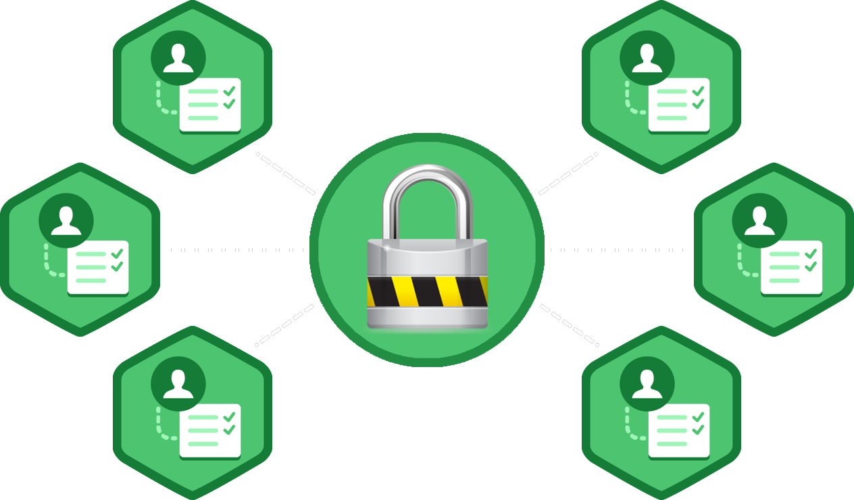
Authentication and Authorization
What's the Difference?

Slide 28
Authentication vs. Authorization
Authentication
The process of verifying the identity of a user or computer
Questions: Who are you? How you prove it?
Credentials can be password, smart card, external token, etc.
Authorization
The process of determining what a user is permitted to do on a computer or network
Questions: What are you allowed to do? Can you see this page?

Slide 29
ASP.NET Core Identity

Slide 30

ASP.NET Identity
The ASP.NET Core Identity system
Authentication and authorization system for ASP.NET Core Web apps
Supports ASP.NET MVC, Web API, SignalR
Handles Users, User Profiles, Login / Logout, Roles, etc.
Keeps the user accounts in local database or in external data store

Slide 31
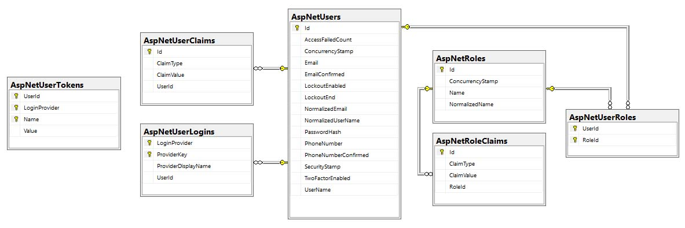
ASP.NET Core Identity
Typically, the ASP.NET Core identity data is stored in relational database
Data is persisted using Entity Framework Core
You have some control over the internal database schema

Slide 32
ASP.NET Identity System Setup
Ways to setup ASP.NET Identity based authentication in MVC
Using the ASP.NET project templates from Visual Studio
By hand: Install NuGet packages, manual configuration, create EF mappings (models), view models, controllers, views, etc.
Required NuGet packages
Microsoft.AspNetCore.Identity.EntityFrameworkCore
Microsoft.AspNetCore.Identity
Microsoft.AspNetCore.Owin

Slide 33


ASP.NET Core Project Template Authentication (3)
ApplicationDbContext.cs
Holds the EF data context
Provides access to the application’s data using model objects
Startup.cs
Can configure cookie-based authentication
May enable external login (e.g. Facebook login)

Slide 34


ASP.NET Core Project Template Authentication
Password settings – can be defined in Startup.cs
public void ConfigureServices(IServiceCollection services)
{ ...
services.AddDefaultIdentity<IdentityUser>()
.AddEntityFrameworkStores<ApplicationDbContext>()
services.Configure<IdentityOptions>(options =>
{
// Password, lockout, emails, etc.
});
services.ConfigureApplicationCookie(options => { … });
}

Slide 35
User Registration
var newUser = new ApplicationUser()
{
UserName = "maria",
Email = "mm@gmail.com",
PhoneNumber = "+359 2 981 981"
};
var result = await userManager.CreateAsync(newUser, "S0m3@Pa$$");
if (result.Succeeded)
// User registered
else
// result.Errors holds the error messages

Slide 36
User Login / Logout
Login
Logout
bool rememberMe = true;
bool shouldLockout = false;
var signInStatus = await signInManager.PasswordSignInAsync(
"maria", "S0m3@Pa$$", rememberMe, shouldLockout);
if (signInStatus.Succeeded)
// Sucessfull login
else
// Login failed
await signInManager.SignOutAsync();

Slide 37
ASP.NET Authorization
Use the [Authorize] and [AllowAnonymous] attributes to configure Authorized / Anonymous access for Controller / Action
[Authorize]
public class AccountController : Controller
{
// GET: /Account/Login (anonymous)
[AllowAnonymous]
public async Task<IActionResult> Login(string returnUrl) { … }
// POST: /Account/LogOff (for logged-in users only)
[HttpPost]
public async Task<IActionResult> Logout() { … }
}

Slide 38
Check the Currently Logged-In User
// GET: /Account/Roles (for logged-in users only)
[Authorize]
public ActionResult Roles()
{
var currentUser = await userManager.GetUserAsync(this.User);
var roles = await userManager.GetRolesAsync(currentUser);
...
}
// GET: /Account/Data (for logged-in users only)
[Authorize]
public ActionResult Data()
{
var currentUserUsername = await userManager.GetUserName(this.User); var currentUserId = await userManager.GetUserIdAsync(this.User);
...
}

Slide 39
Add User to a Role
Adding a User to existing role:
var roleName = "Administrator";
var roleExists = await roleManager.RoleExistsAsync(roleName);
if (roleExists)
{
var user = await userManager.GetUserAsync(User);
var result = await userManager.AddToRoleAsync(user, roleName);
if (result.Succeeded)
// The user is now Administrator
}

Slide 40
Require Logged-In User in Certain Role
Give access only to Users in Role "Administrator":
Give access if User’s Role is "User", "Student" or "Trainer":
[Authorize(Roles="Administrator")]
public class AdminController : Controller
{ … }
[Authorize(Roles="User, Student, Trainer")]
public ActionResult Roles()
{
…
}

Slide 41
Check the Currently Logged-In User's Role
// GET: /Home/Admin (for logged-in admins only)
[Authorize]
public ActionResult Admin()
{
if (this.User.IsInRole("Administrator"))
{
ViewBag.Message = "Welcome to the admin area!";
return View();
}
return this.View("Unauthorized");
}

Slide 42
ASP.NET Core User Manager
UserManager<TUser> - APIs for managing users in a persistence store
Category
AddClaimsAsync(…) | FindByEmailAsync(…) | GenerateChangeEmailTokenAsync(…)
AddToRoleAsync(…) | FindByIdAsync(…) | GenerateEmailConfirmationTokenAsync(…)
IsInRoleAsync(…) | FindByNameAsync(…) | GeneratePasswordResetTokenAsync(…)
GetUserId(…) | GetClaimsAsync(…) | GetAuthenticationTokenAsync(…)
ConfirmEmailAsync(…) | GetEmailAsync(…) | IsEmailConfirmedAsync(…)
ChangeEmailAsync(…) | GetRolesAsync(…) | CreateSecurityTokenAsync(…)
CreateAsync(…) | GetUserAsync(…) | ResetPasswordAsync(…)
DeleteAsync(…) | CheckPasswordAsync(…) | RemoveFromRoleAsync(…)
Dispose(…) | UpdateAsync(…) | RemoveClaimsAsync(…)

Slide 43
Claims
Claim-based identity is a common technique used in applications
Applications acquire identity info about their users through Claims
A Claim is a statement that one subject makes about itself
It can be about a name, group, ethnicity, privilege, association etc.
The subject making the claim is a provider
Claim-based identity simplifies authentication logic
Commonly used in individual application parts, or micro-apps
No mechanism is required for account creation / modification

Slide 44
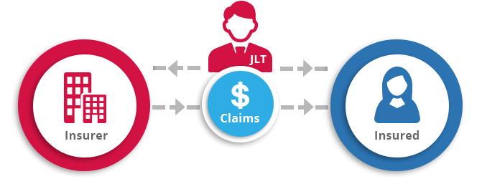
Claims
In ASP.NET Core, Claim-based auth checks are declarative
The developer embeds them against a Controller or an Action
The developer specifies required claims to access the functionality
Claims requirements are policy based
The developer must register a policy expressing claims requirements
Claims are name-value pairs

Slide 45
Claims
The simplest type of claim policy checks only for the presence of a claim
The value of the claim is not checked
public void ConfigureServices(IServiceCollection services)
{
...
services.AddAuthorization(options =>
{
options.AddPolicy("EmployeeOnly", policy => policy.RequireClaim("EmployeeNumber"));
});
}
[Authorize(Policy = "EmployeeOnly")]
public IActionResult VacationBalance()
{
//This action is accessible only by Identities with the "EmployeeOnly" Claim...
return View();
}

Slide 46

Identity – Extending & Scaffolding

Slide 47
Scaffolding ASP.NET Core Identity
As of ASP.NET Core 2.1, Identity is provided as a Razor Class Library
The scaffolder can be configured to generate source code
If you need to modify the code and change the behavior
Most of the necessary code is generated by the scaffolder
Your project will need an update, before the process is complete
The scaffolder generates a helpful ScaffoldingReadme.txt file
Contains instructions on what’s needed to complete the scaffolding
Source control is suggested, before attempting scaffolding

Slide 48
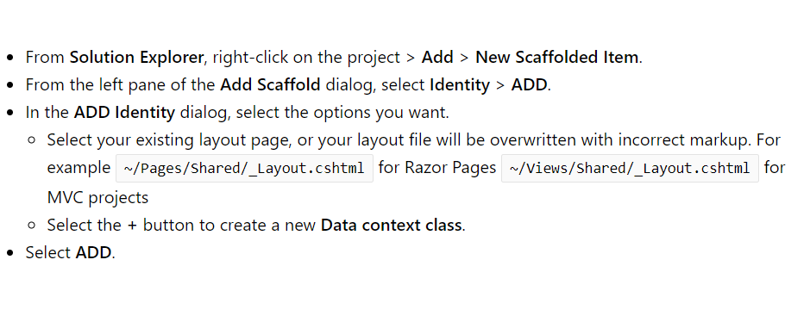
Scaffolding ASP.NET Core Identity
Live Demo

Slide 49

Extending ASP.NET Core Identity
ApplicationUser.cs – can add user functionality
Extends the user information for the ASP.NET Core application derived from IdentityUser
Id (unique User Id, string holding a GUID)
E.g. 313c241a-29ed-4398-b185-9a143bbd03ef
Username (unique username), e.g. maria
Email (email address – can be unique), e.g. mm@gmail.com
May hold additional fields, e.g. first name, last name, date of birth

Slide 50
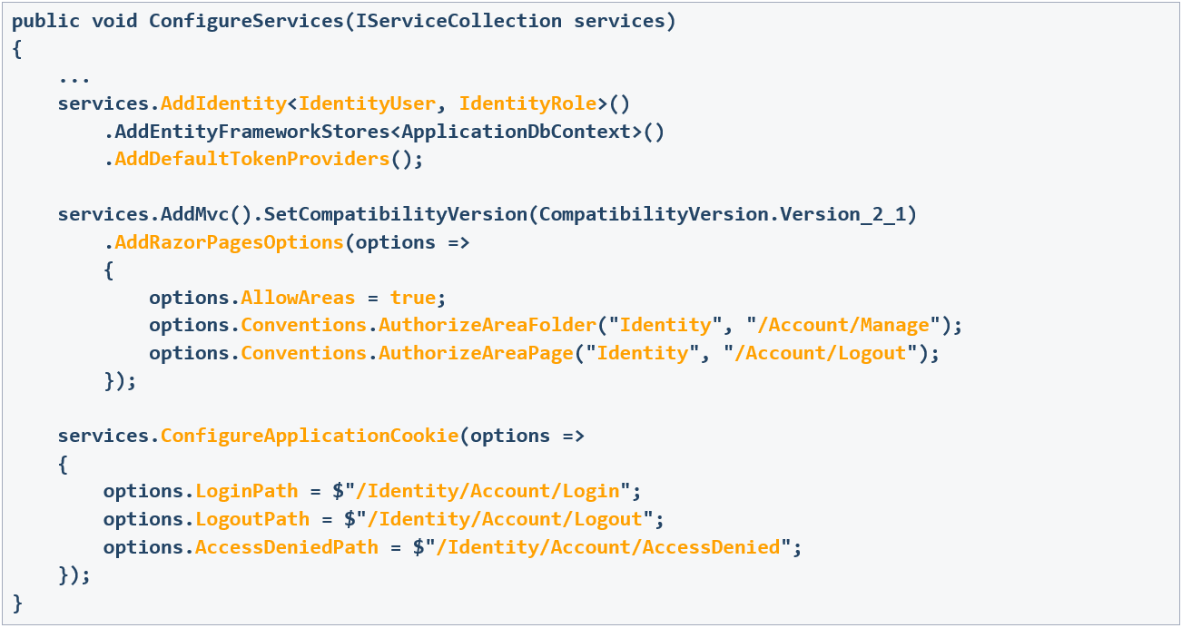
Gaining Full Control over Identity UI

Slide 51
Gaining Full Identity Control
The default identity behavior is replaced with a custom such
You implement a custom User and a Custom User Role
public void ConfigureServices(IServiceCollection services)
{
...
services.AddIdentity<IdentityUser, IdentityRole>()
// services.AddDefaultIdentity<IdentityUser>()
.AddEntityFrameworkStores<ApplicationDbContext>()
.AddDefaultTokenProviders();
...
}

Slide 52
Gaining Full Identity Control
The following sets the LoginPath, LogoutPath, AccessDeniedPath
public void ConfigureServices(IServiceCollection services)
{
...
services.ConfigureApplicationCookie(options =>
{
options.LoginPath = $"/Identity/Account/Login";
options.LogoutPath = $"/Identity/Account/Logout";
options.AccessDeniedPath = $"/Identity/Account/AccessDenied";
});
...
}

Slide 53




Authentication & Authorization Types
There are many types of auth in ASP.NET Core applications
Cookie-based Authentication & Authorization (Identity)
Windows Authentication & Authorization
Cloud-based Authentication & Authorization
JSON Web Tokens (JWT) Authentication & Authorization

Slide 54

GDPR
General Data Protection Regulation (GDPR) is a regulation in EU law
Addresses data protection and privacy of individuals within the EU
It also addresses export of personal data outside of the EU
GDPR aims to:
Provide individuals with more control over their personal data
Simplify the regulatory environment for international businesses
ASP.NET Core provides APIs to help meet some GDPR requirements
There is also a sample app in GitHub here

Slide 55
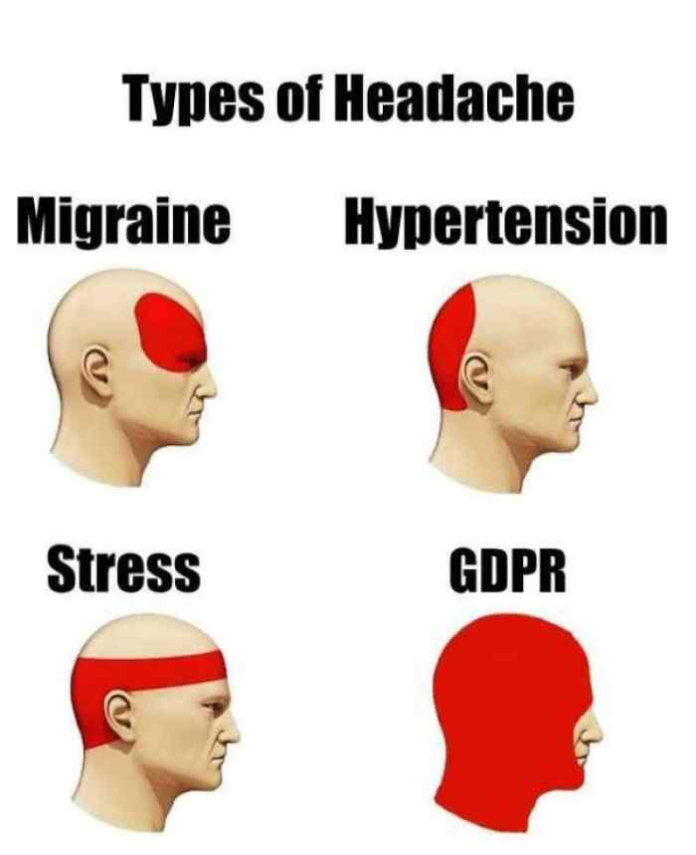
GDPR
There are several individual rights you must provide your clients
Right to be informed
Right of access
Right to rectification
Right to erasure
Right to restrict processing
Right to portability
Right to object
Rights related to automatic decision making, including profiling

Slide 56
Multi-Factor Authentication
Two-factor authentication (2FA) is an additional security layer
Also known as Multi-factor Authentication (MFA)
Fixes some vulnerabilities of a standard password-only approach
Some two-factor authentication types include
SMS, Email, Push-based, TOTP, U2F etc.
Two-factor authentication is pretty common nowadays
Bank apps, Health platforms, Web Stores, Government apps

Slide 57

Summary
Security Fundamentals
What are the most important concepts?
Security attacks
SQL Injection, XSS, CSRF, Parameter Tampering
Other attacks
ASP.NET Core Identity
Types of Authentication & Authorization
GDPR
…
…
…

Slide 58
https://softuni.bg/trainings/courses

Slide 59













SoftUni Diamond Partners

Slide 60





SoftUni Organizational Partners

Slide 61




Trainings @ Software University (SoftUni)
Software University – High-Quality Education and Employment Opportunities
softuni.bg
Software University Foundation
http://softuni.foundation/
Software University @ Facebook
facebook.com/SoftwareUniversity
Software University Forums
forum.softuni.bg

Slide 62

License
This course (slides, examples, demos, videos, homework, etc.) is licensed under the "Creative Commons Attribution-NonCommercial-ShareAlike 4.0 International" license

